Slide 1
LAB OVERVIEW

Slide 2
prerequisites

Slide 3
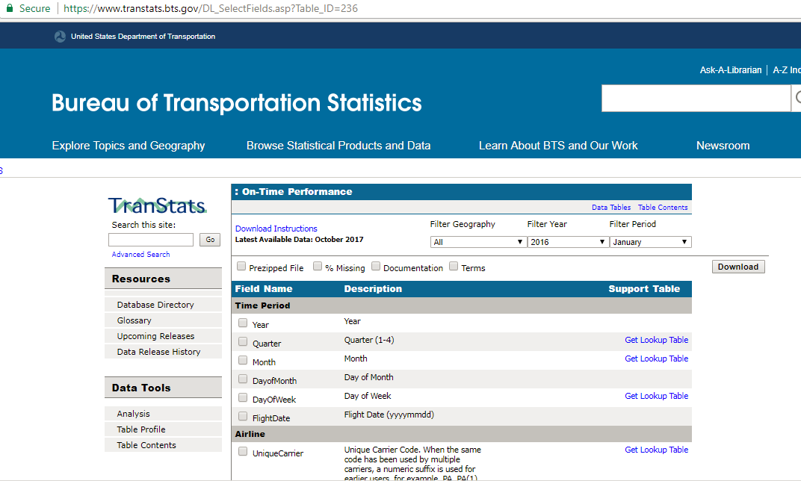
Candidate Data Set

Slide 4
Lab Overview
Module 1 – Setting Up ADF and Resources
Module 2 – Lift and Shift of SSIS to Azure
Module 3 – Rebuilding the Extract and Load with ADF
Module 4 – Enhancing Data with Cloud Services
Module 5 – Transform and Merge Data with ADF and HDInsight
Module 6 – Load Data into DW with ADF
Module 7 – Scheduling your ADF
Module 8 – Monitoring your ADF
Module 9 – Bringing it all Together

Slide 5
Module 1 – Setting Up ADF and Resources

Slide 6
Module 1 Goal
Deploy and configure all the resources needed for upcoming labs.

Slide 7
Lab Task Overview
Configure and deploy PowerShell script for Azure Services
Configure Office365 API Connection for sending email notifications
Create Azure Data Factory

Slide 8
Prerequisites
Deployment files for this Lab downloaded to a local folder
Azure Subscription with rights to use/deploy Azure services
Azure PowerShell
SQL Server Management Studio
Microsoft Azure Storage Explorer (Optional)
Web browser (Edge/Chrome recommended)

Slide 9
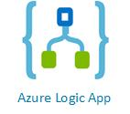
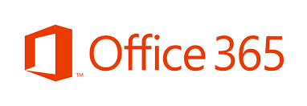
Technologies Leveraged
PowerShell
Azure SQL Database
Azure Blob Storage
Azure Data Factory
Azure SQL Data Warehouse
Azure Logic App
Office 365

Slide 10
Lab Overview
Module 1 – Setting Up ADF and Resources
Module 2 – Lift and Shift of SSIS to Azure
Module 3 – Rebuilding the Extract and Load with ADF
Module 4 – Enhancing Data with Cloud Services
Module 5 – Transform and Merge Data with ADF and HDInsight
Module 6 – Load Data into DW with ADF
Module 7 – Scheduling your ADF
Module 8 – Monitoring your ADF
Module 9 – Bringing it all Together

Slide 11
Module 2 – Lift and Shift of SSIS to Azure

Slide 12
Module 2 Goal
Use Azure Data Factory Integration Runtime to schedule then execute a SSIS Package to simulate a typical Data Warehouse Extract, Transform, and Load cycle.

Slide 13
Prerequisites
Azure Subscription with rights to use/deploy Azure services
SQL Server Management Studio
Azure Resources created in Module 1
SSIS Package located in Lab Module folder

Slide 14
Lab Task Overview
Create Azure SSIS Integration Runtime
Upload SSIS Package to Integration Services Catalog
Manually Execute and Monitor Package Execution
Create Pipeline and Trigger based Execution

Slide 15
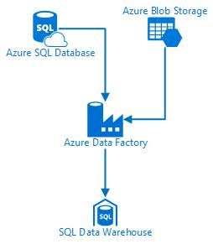
Technologies Leveraged
Azure SQL Database
Azure Blob Storage
Azure Data Factory
Azure SQL Data Warehouse

Slide 16
Lab Overview
Module 1 – Setting Up ADF and Resources
Module 2 – Lift and Shift of SSIS to Azure
Module 3 – Rebuilding the Extract and Load with ADF
Module 4 – Enhancing Data with Cloud Services
Module 5 – Transform and Merge Data with ADF and HDInsight
Module 6 – Load Data into DW with ADF
Module 7 – Scheduling your ADF
Module 8 – Monitoring your ADF
Module 9 – Bringing it all Together

Slide 17
Module 3 – Rebuilding the Extract and Load with ADF

Slide 18
Module 3 Goal
Create a pipeline copy activity to copy a file from an S3 storage location to an Azure blob storage container in preparation for later transformations.

Slide 19
Lab Task Overview
Show the graphical user interface for creating a pipeline
Copy CSV file via a Copy Activity
Creating branching success and failure paths to send an email
Use parameters to make the pipeline easy to change and more reusable
Call an Azure Logic app to send an email via a Web Activity

Slide 20
Prerequisites
Azure Subscription with rights to use/deploy Azure services
Azure Data Factory created in Module 1
Visual Studio Team Services Git project (optional)

Slide 21
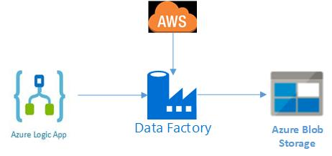
Technologies Leveraged
AWS S3 (as data source)
Azure Blob Storage
Azure Data Factory
Azure Logic App

Slide 22
Lab Overview
Module 1 – Setting Up ADF and Resources
Module 2 – Lift and Shift of SSIS to Azure
Module 3 – Rebuilding the Extract and Load with ADF
Module 4 – Enhancing Data with Cloud Services
Module 5 – Transform and Merge Data with ADF and HDInsight
Module 6 – Load Data into DW with ADF
Module 7 – Scheduling your ADF
Module 8 – Monitoring your ADF
Module 9 – Bringing it all Together

Slide 23
Module 4 – Enhancing Data with Cloud Services

Slide 24
Module 4 Goal
Create a pipeline copy activity to copy web REST API weather data to a local file in Azure blob storage for later transformations.

Slide 25
Prerequisites
Azure Subscription with rights to use/deploy Azure services
Azure Data Factory created in Module 1
Azure Blob storage container from Module 3
Restful API configured for GET access with key

Slide 26
Lab Task Overview
Show the Copy Data wizard to configure the pipeline
Configure the HTTP Source
Chain one pipeline to another using the Execute Pipeline activity

Slide 27
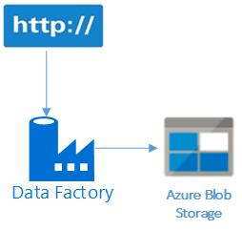
Technologies Leveraged
Web data source
Azure Blob Storage
Azure Data Factory

Slide 28
Lab Overview
Module 1 – Setting Up ADF and Resources
Module 2 – Lift and Shift of SSIS to Azure
Module 3 – Rebuilding the Extract and Load with ADF
Module 4 – Enhancing Data with Cloud Services
Module 5 – Transform and Merge Data with ADF and HDInsight
Module 6 – Load Data into DW with ADF
Module 7 – Scheduling your ADF
Module 8 – Monitoring your ADF
Module 9 – Bringing it all Together

Slide 29
Module 5 – Transform and Merge Data with ADF and HDInsight

Slide 30
Module 5 Goal
Create a pipeline Hive activity to merge the FAAmaster and FAAaircraft data together into one file, leveraging Hive for transformation activities.

Slide 31
Prerequisites
Azure Subscription with rights to use/deploy Azure services
Azure Data Factory created in Module 1
FAA Master and FAA Aircraft Hive Script files in Azure Storage from Module 1
Azure Blob storage container from Module 3

Slide 32
Lab Task Overview
Show the Hive activity to run Hive scripts against an HDInsight cluster
Configure the Hive activity
Chain one pipeline to another using the Execute Pipeline activity

Slide 33
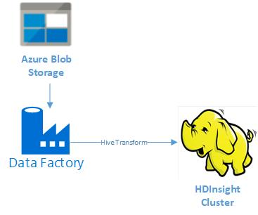
Technologies Leveraged
Azure Blob Storage
Azure Data Factory
Hive
Azure HDInsight Clusters

Slide 34
Lab Overview
Module 1 – Setting Up ADF and Resources
Module 2 – Lift and Shift of SSIS to Azure
Module 3 – Rebuilding the Extract and Load with ADF
Module 4 – Enhancing Data with Cloud Services
Module 5 – Transform and Merge Data with ADF and HDInsight
Module 6 – Load Data into DW with ADF
Module 7 – Scheduling your ADF
Module 8 – Monitoring your ADF
Module 9 – Bringing it all Together

Slide 35
Module 6 – Load Data into DW with ADF

Slide 36
Module 6 Goal
Create a pipeline to load the Azure SQL Data Warehouse dimension and fact tables from Azure SQL Database tables and flat files.

Slide 37
Prerequisites
Azure Subscription with rights to use/deploy Azure services
Azure Data Factory created in Module 1
Azure Linked Service created in Module 3

Slide 38
Lab Task Overview
Create a Stored Procedure activity to truncate our staging tables
Create Copy activities to copy Azure DB and Azure Blob files to the staging schema
Create Stored Procedure activities to call a load dimensions and load fact stored procedure on the Azure DW database

Slide 39
Technologies Leveraged
Azure Blob Storage
Azure SQL Database
Azure Data Factory
Azure SQL Data Warehouse

Slide 40
Lab Overview
Module 1 – Setting Up ADF and Resources
Module 2 – Lift and Shift of SSIS to Azure
Module 3 – Rebuilding the Extract and Load with ADF
Module 4 – Enhancing Data with Cloud Services
Module 5 – Transform and Merge Data with ADF and HDInsight
Module 6 – Load Data into DW with ADF
Module 7 – Scheduling your ADF
Module 8 – Monitoring your ADF
Module 9 – Bringing it all Together

Slide 41
Module 7 – Scheduling your ADF

Slide 42
Module 7 Goal
Schedule a pipeline run from the Azure Data Factory GUI with the Schedule trigger for Time

Slide 43
Prerequisites
Azure Subscription with rights to use/deploy Azure services
Azure Data Factory created in Module 1

Slide 44
Lab Task Overview
Rename the Pipeline
Schedule the Pipeline

Slide 45
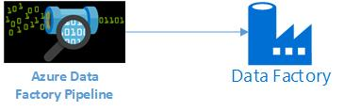
Technologies Leveraged
Azure Data Factory
Azure Data Factory Pipeline
Azure Data Factory Pipeline Trigger

Slide 46
Lab Overview
Module 1 – Setting Up ADF and Resources
Module 2 – Lift and Shift of SSIS to Azure
Module 3 – Rebuilding the Extract and Load with ADF
Module 4 – Enhancing Data with Cloud Services
Module 5 – Transform and Merge Data with ADF and HDInsight
Module 6 – Load Data into DW with ADF
Module 7 – Scheduling your ADF
Module 8 – Monitoring your ADF
Module 9 – Bringing it all Together

Slide 47
Module 8 – Monitoring your ADF

Slide 48
Module 8 Goal
Use Azure Data Factory monitoring tools to view information about your triggers, pipelines, and integration runtimes.

Slide 49
Prerequisites
Azure Subscription with rights to use/deploy Azure services
Azure Data Factory created in Module 1
Azure Data Factory Pipeline with a fired trigger from Module 7

Slide 50
Lab Task Overview
Monitor Pipeline execution including drilling down to actvities executed
Monitor the status of our trigger event
View the status of the integration runtimes

Slide 51
Technologies Leveraged
Azure Data Factory
Azure Data Factory Pipeline
Azure Data Factory Pipeline Trigger

Slide 52
Lab Overview
Module 1 – Setting Up ADF and Resources
Module 2 – Lift and Shift of SSIS to Azure
Module 3 – Rebuilding the Extract and Load with ADF
Module 4 – Enhancing Data with Cloud Services
Module 5 – Transform and Merge Data with ADF and HDInsight
Module 6 – Load Data into DW with ADF
Module 7 – Scheduling your ADF
Module 8 – Monitoring your ADF
Module 9 – Bringing it all Together

Slide 53
Module 9 – Bringing it all Together

Slide 54
Module 9 Goal
Verify and explore the results of our loaded data warehouse using SQL queries.

Slide 55
Prerequisites
Azure Subscription with rights to use/deploy Azure services
Azure Data Factory created in Module 1
Complete previous lab modules 3 - 7 to ensure data is loaded in Azure SQL Data Warehouse
SQL Server Management Studio

Slide 56
Lab Task Overview
Run queries via SQL Server Management Studio
Explore Data

Slide 57
Lab Overview
Module 1 – Setting Up ADF and Resources
Module 2 – Lift and Shift of SSIS to Azure
Module 3 – Rebuilding the Extract and Load with ADF
Module 4 – Enhancing Data with Cloud Services
Module 5 – Transform and Merge Data with ADF and HDInsight
Module 6 – Load Data into DW with ADF
Module 7 – Scheduling your ADF
Module 8 – Monitoring your ADF
Module 9 – Bringing it all Together

Slide 58
Get started with Azure Data Factory
https://azure.microsoft.com/en-us/services/data-factory/
View pricing
https://azure.microsoft.com/en-us/pricing/details/data-factory/

